Slide 1
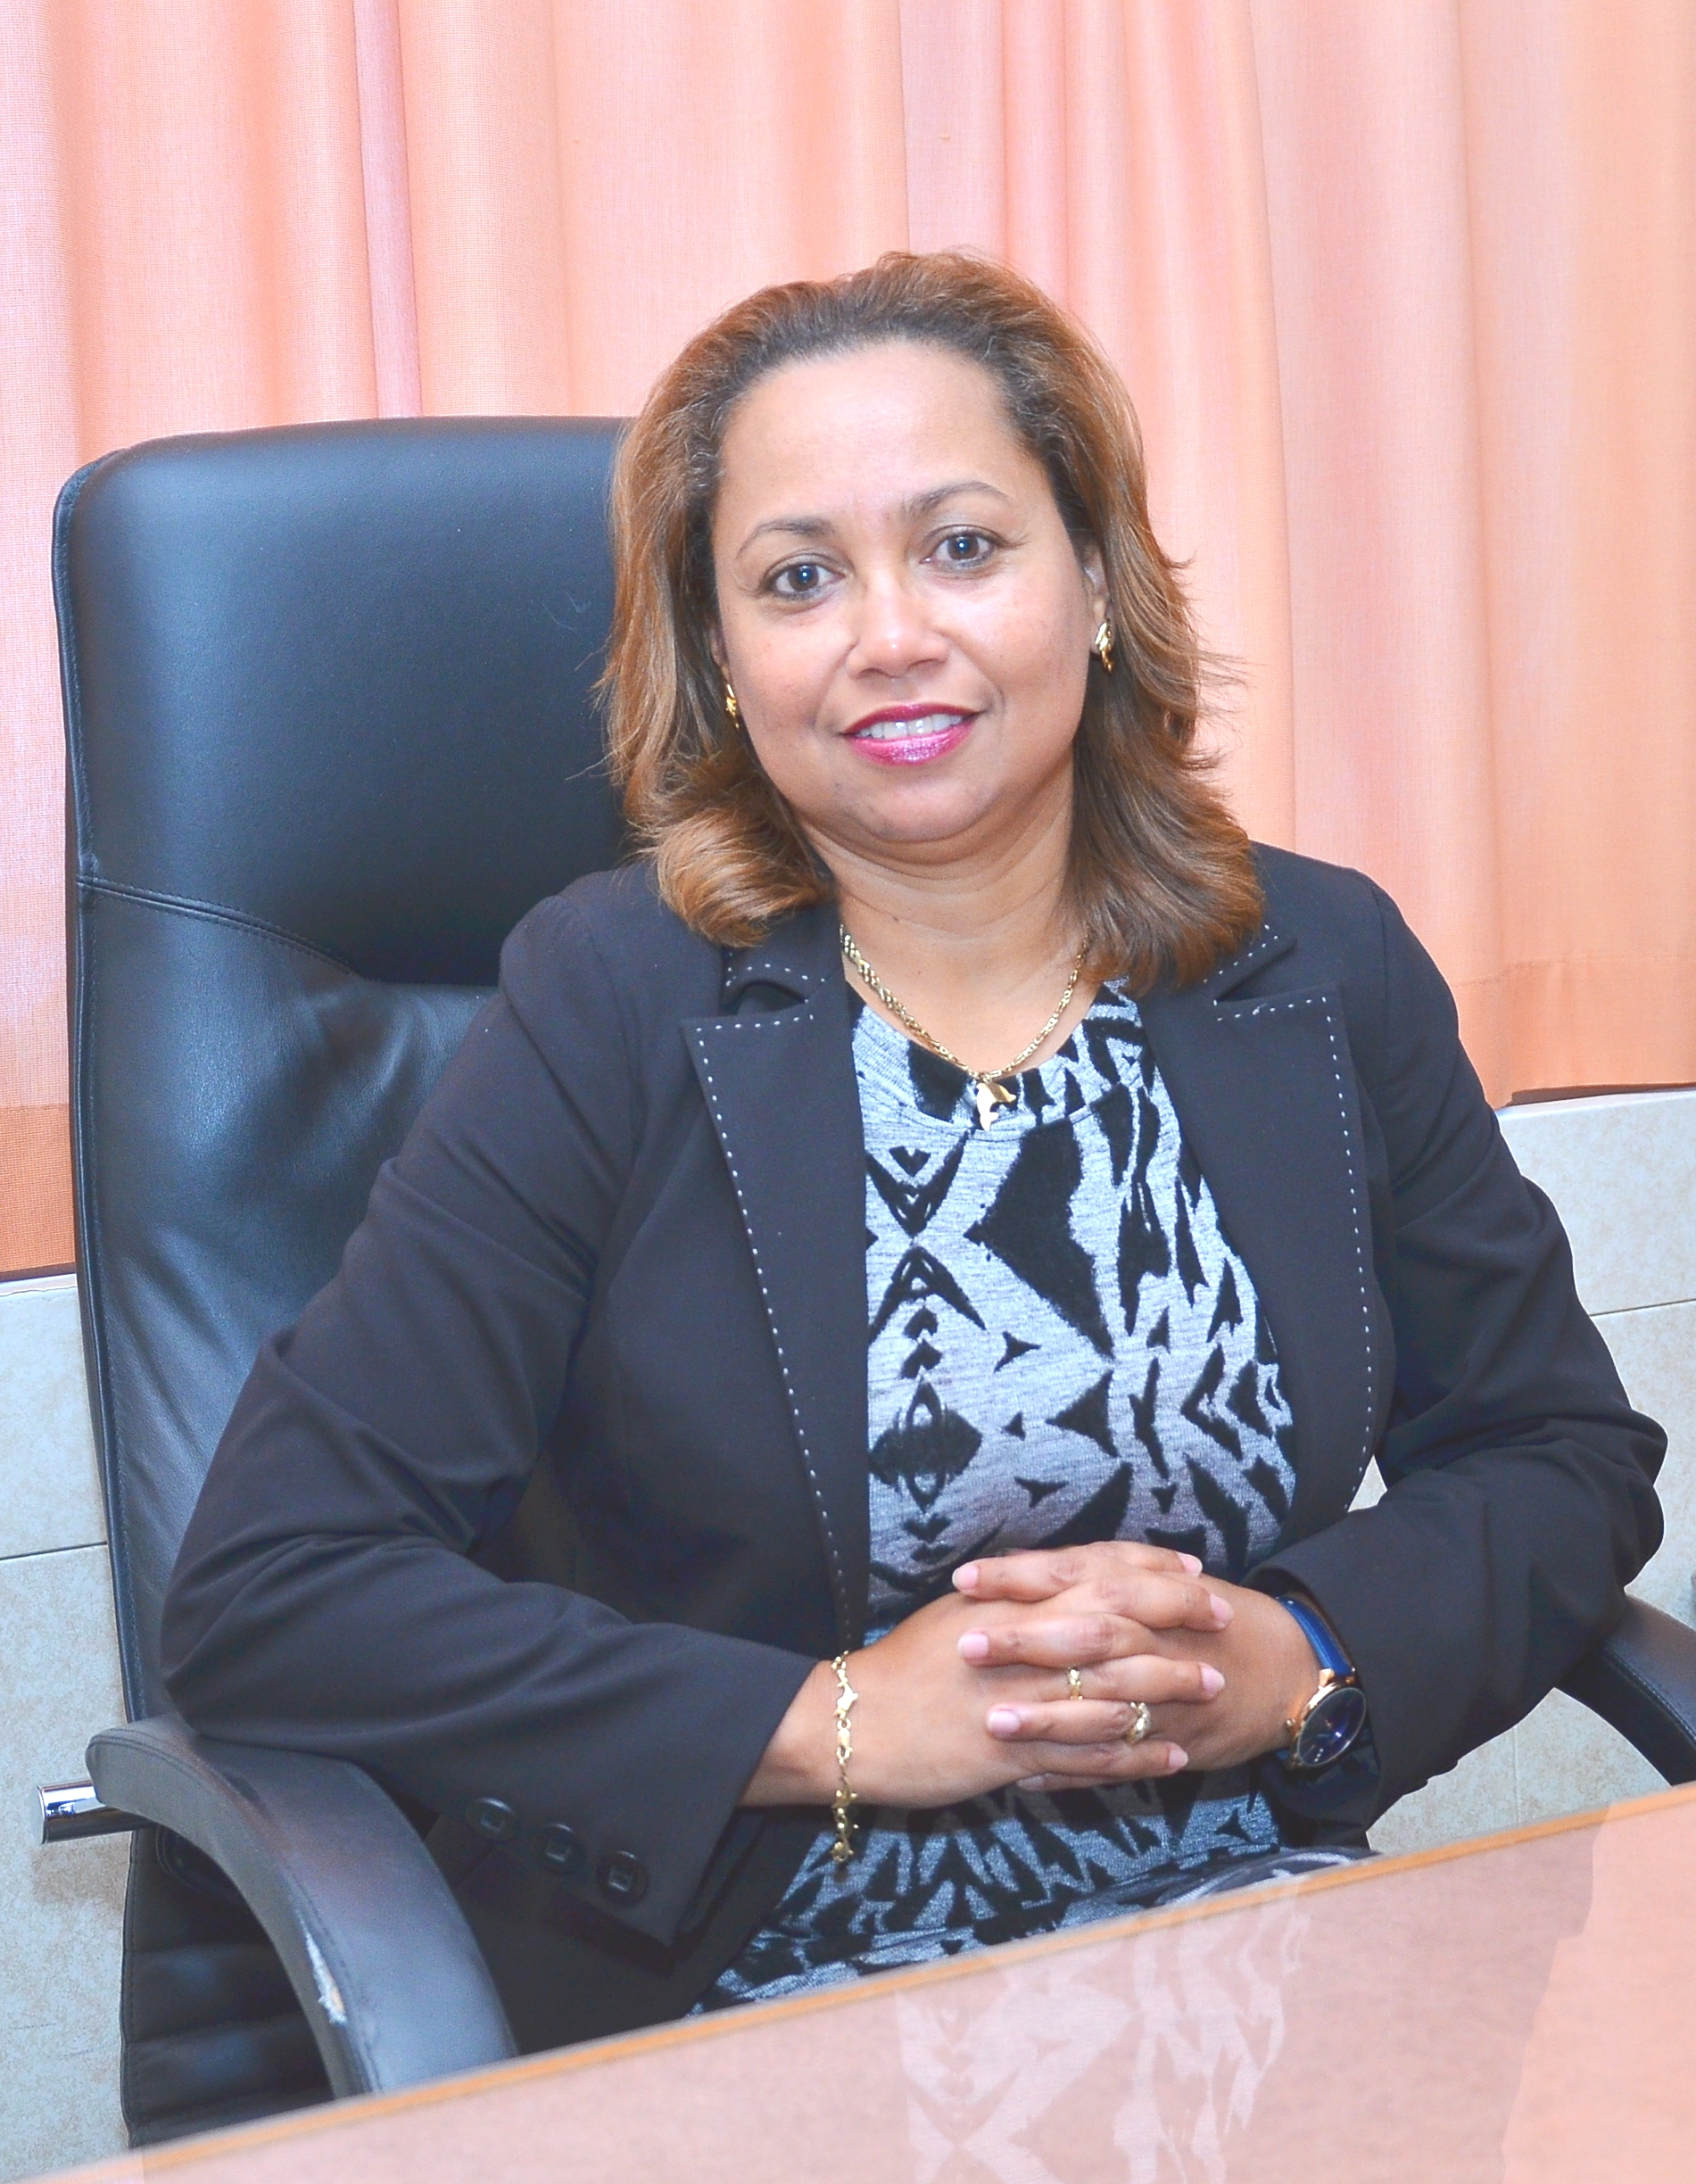
LIVE FROM SOUTHAMPTON ENGLAND
A Global Outlook: The Recovery of Cruise Tourism
Dr. Sheree-Ann Adams PhD
Adjunct Professor ~ SSB - CBU
Tourism Advisor ~ TSL Grenada
Tourism Destination Marketing and Management in a Post-Covid Environment
World Tourism Institute Shannon School of Business Cape Breton University Nova Scotia Canada
Virtual Conference
November 10th, 2020

Slide 2
Cruise Tourism Recovery: Hope Flow Chart ADAMS (2020)

Slide 3
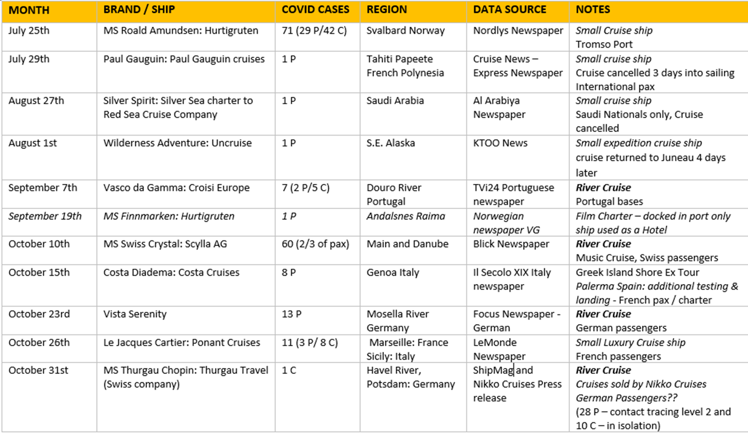
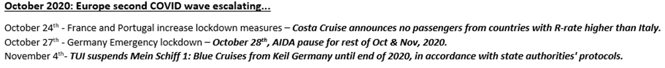

Slide 4
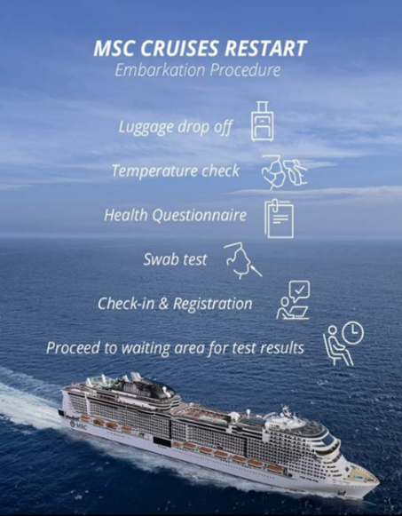
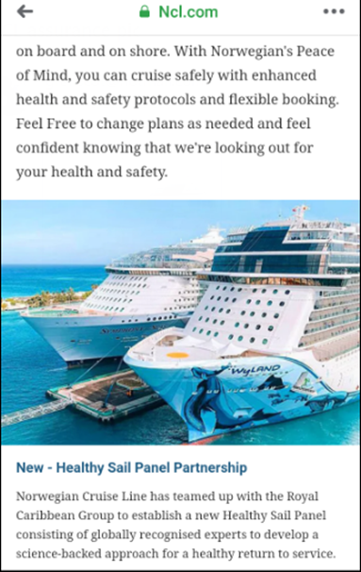
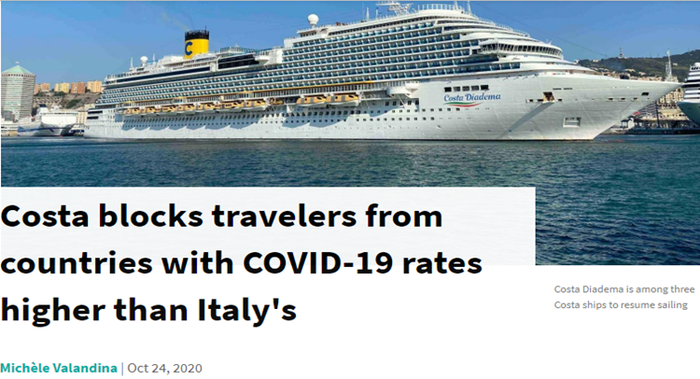
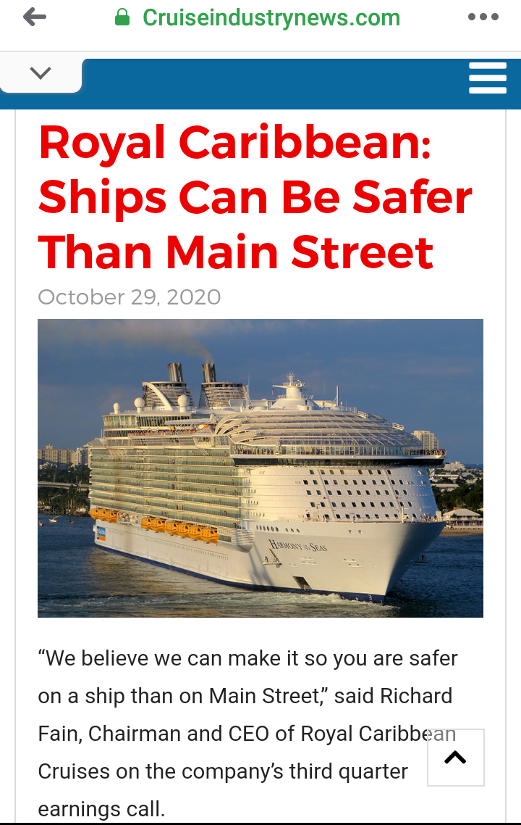
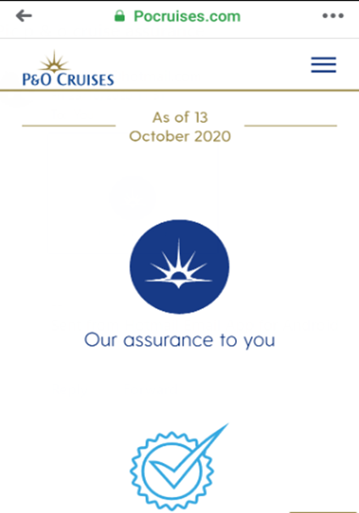
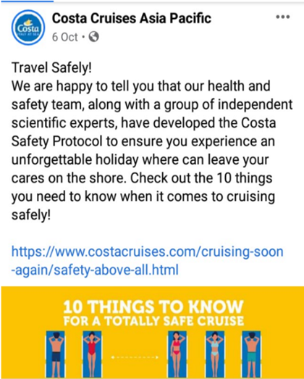
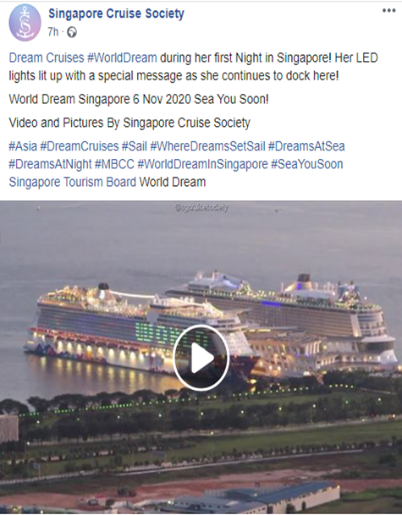

Slide 5
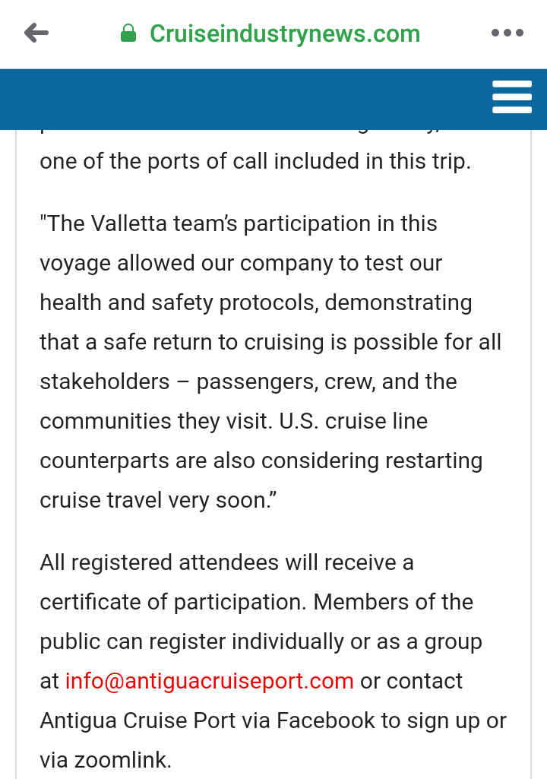
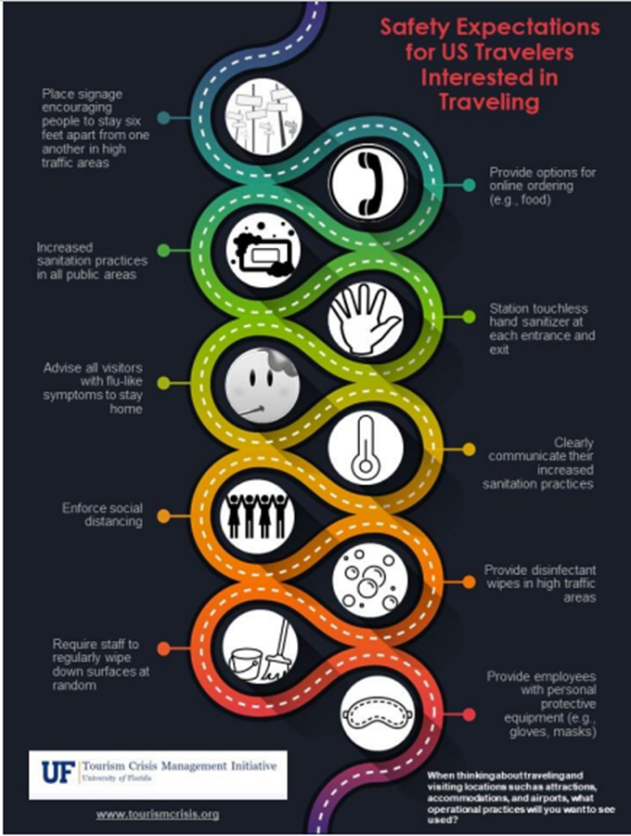


Slide 6
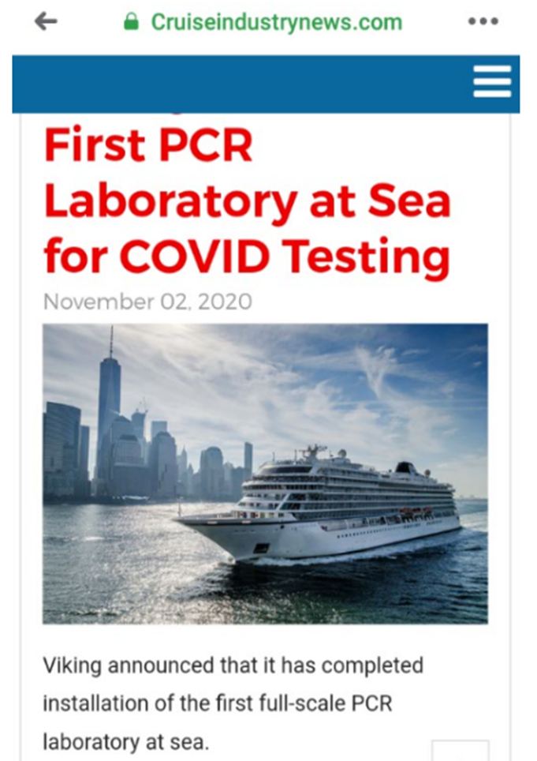

MEDICAL / SAFETY SOLUTION
Vaccine remains crucial to return to pre-COVID status
Reduced operating capacity on ships & COVID testing
Covid era Health & Safety measures the new norm
WILLINGNESS OF PEOPLE TO TRAVEL ON CRUISE SHIPS
Building Cruise Consumer Confidence
Existing repeat cruise passengers
DESTINATIONS (PORTS) READINESS & WELCOME THE SHIPS
Duration of Ships in Port / Destination Carrying Capacity
Shore Excursions
Crew
Cruise Duration

Slide 7
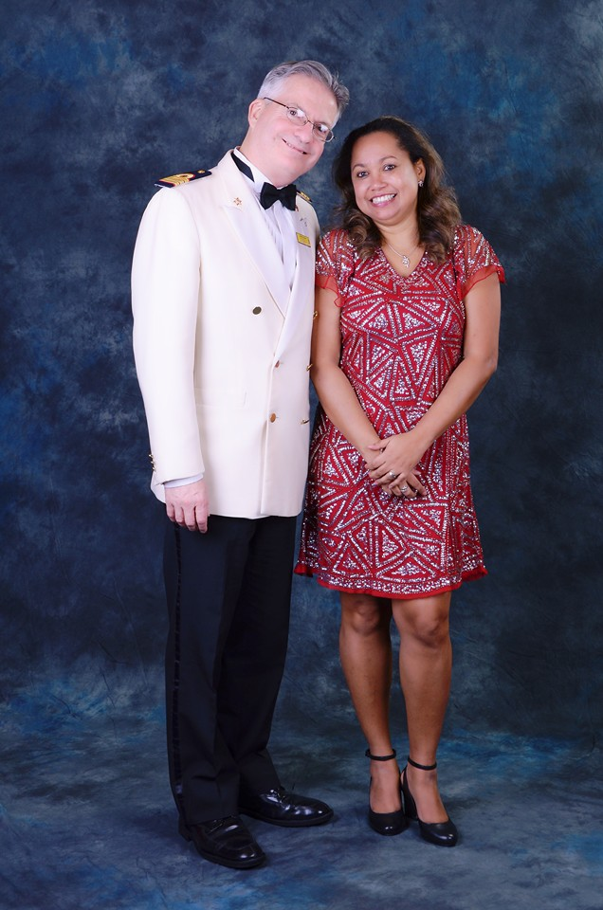
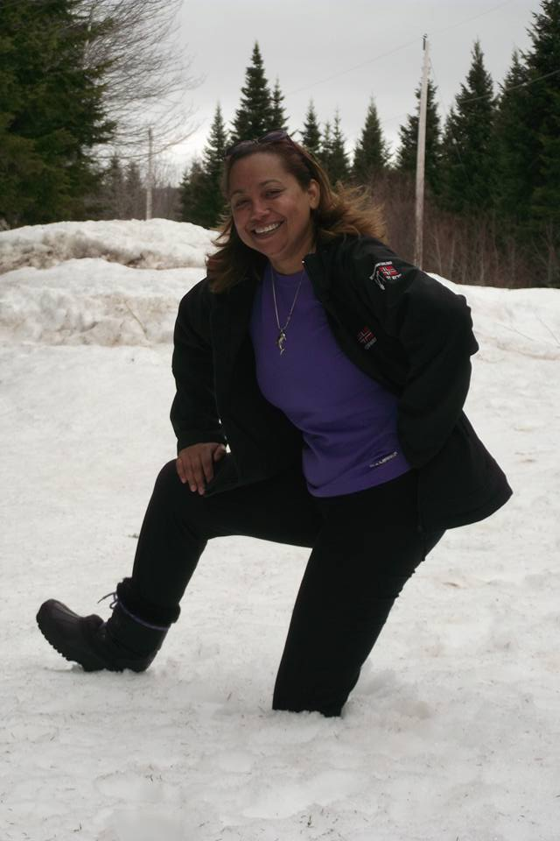
Thank You!

